Slide 1
Municipality of South Bruce
Community Survey
August 2023
Notes:
Image Source: Gallery - Visit South Bruce

Slide 2
The purpose of the 2023 South Bruce Community Survey was to:
Research Objectives and Methodology
Objectively measure resident awareness of the Nuclear Waste Management Organization (NWMO) project.
Understand how informed the community feels and identify additional information needed to ensure residents are able to make an informed decision at the 2024 referendum.
The survey used the following data collection method:
A web-enabled mailout survey was sent out to over 2,300 ratepayer households in the Municipality using post cards with unique pin codes. Respondents were also able to complete the survey via telephone or hardcopy. ​
Results were screened to ensure quality and reliability using Deloitte’s in-depth Quality Control process (described on next slide).
Respondents were screened to ensure they reside or own property within the Municipality of South Bruce and are over the age of 18.
The survey responses have been weighted by age according to the 2021 Canadian Census profile for the Municipality of South Bruce to ensure the findings are representative of the population.​
The sample size resulted in a +/-7.0% margin of error at a 95% confidence level, showing that the results accurately represent the population of South Bruce.
This methodology resulted in 198 statistically valid completes. ​
Community Survey – Municipality of South Bruce 2023

Slide 3
Data Cleaning and Quality Control
The responses were screened to ensure data quality and reliability
Upon closing of the survey, all responses were scanned in detail using Deloitte’s in-depth Quality Control process.
This process was used to detect any potential duplicates or invalid cases, using a combination of several response criteria including the following:
Assigned PIN numbers
IP Address
Start/end time of survey
Length of survey
Response similarity
Using this methodology, we detected 88 invalid survey responses which were removed from the final results.
71 responses were from the same device, and the remaining invalid responses came from 8 others.
The final data was assessed by multiple researchers to ensure the quality, validity and reliability of the survey results.
Community Survey – Municipality of South Bruce 2023

Slide 4
Municipality of South Bruce 2023 Community Survey
Detailed Findings from Market Research Data
Methodological Note: Throughout out the report, some percentages may not add to 100% due to rounding.
Community Survey – Municipality of South Bruce 2023

Slide 5
Meeting Future Community Needs
62% of respondents agreed that the Municipality of South Bruce is taking the right actions to meet the future needs of the community.
62%
To what extent do you agree that the Municipality of South Bruce is taking the right actions to meet the future needs of the community?
N=198
Community Survey – Municipality of South Bruce 2023

Slide 6
Meeting Future Community Needs
59% of respondents agreed that the Municipality of South Bruce is moving in the right direction on the proposed Nuclear Waste Management Organization project.
To what extent do you agree that the Municipality of South Bruce is moving in the right direction on each of the following topics?
N=198
Community Survey – Municipality of South Bruce 2023

Slide 7
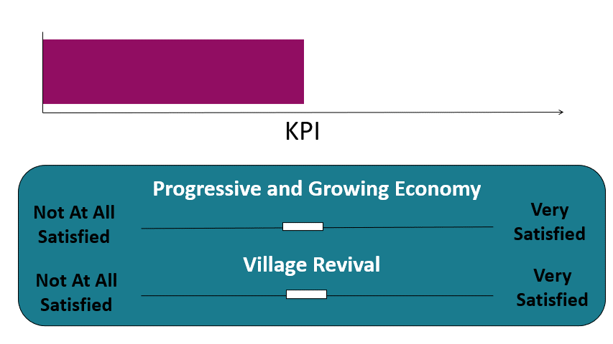
Derived Importance
Derived Importance Explanation
Derived importance is a methodology for calculating importance without asking it directly. This is used to understand the subconscious factors driving residents’ overall agreement with the direction of the Municipality. To calculate derived importance, the following is required:
Overall Agreement: An overall Key Performance Indicator (KPI) is needed, in this case that would be “To what extent do you agree that the Municipality of South Bruce is taking the right actions to meet the future needs of the community?”.
Example:
Overall Direction of Municipality
Factors: Next, we would ask if respondents agree that the Municipality of South Bruce is moving in the right direction on various factors.
Importance: Using these data points, we can then calculate how strongly each factor impacts overall agreement with the direction of the Municipality. Factors that are very important will have a large influence on residents’ overall agreement that the Municipality is taking the right actions to meet the future needs of the community.
Community Survey – Municipality of South Bruce 2023

Slide 8
Future Community Needs – Derived Importance
Using Deloitte’s proprietary derived importance methodology, it was found that a progressive and growing economy and the proposed NWMO project are highly important to community members. These factors have the highest impact on community members’ agreement that the the Municipality of South Bruce is taking the right actions to meet the future needs of the community
Factor | Importance
Progressive and growing economy | 9.4
The proposed Nuclear Waste Management Organization (NWMO) Project | 8.6
Healthy and vibrant communities | 7.6
Environmental stewardship | 6.4
Village revival | 6.4
Agri-business reboot | 6.4
Community Survey – Municipality of South Bruce 2023

Slide 9
NWMO Project
Respondents were shown/read the following information about the Nuclear Waste management Organization (NWMO) project:
The Municipality of South Bruce is home to one of two final sites that the Nuclear Waste Management Organization (NWMO) is considering to securely store Canada’s used nuclear fuel in a deep geological repository (DGR).
The federal government tasked the NWMO with finding a safe, permanent solution for Canada’s used nuclear fuel. Globally, storing the waste in a reinforced facility deep underground is considered the safest long-term option.
The proposed facility would be about 660-metres underground, with a Centre of Expertise and other facilities above ground.
The Project will only come to South Bruce if it is safe for people and the environment, the community demonstrates willingness to host it, and it provides meaningful benefits to the community. The Municipality has hired consultants to conduct studies, and to independently review the NWMO studies related to the Project. You can read more at: www.southbruce.ca/Studies.
The NWMO is seeking a willing and informed community to host the facility. The Municipality plans to hold a referendum next year to measure community willingness.
Community Survey – Municipality of South Bruce 2023

Slide 10
NWMO Project
The vast majority of respondents (97%) were at least somewhat familiar with the NWMO project.
97%
How familiar are you with the NWMO project that was just described?
N=198
Community Survey – Municipality of South Bruce 2023

Slide 11
NWMO Project
Respondents most commonly recall receiving information regarding the NWMO project from 2-4 page informational mail-outs (82%) and the Monthly Community Liaison Committee flyer (77%).
*Other responses include word of mouth, online research, and Protect Our Waterways No Nuclear Waste (POW NNW).
From which of the following sources do you recall receiving information regarding the NWMO project from the Municipality:
Respondents were able to select multiple options, therefore totals may be greater than 100%.
N=198
Community Survey – Municipality of South Bruce 2023

Slide 12
NWMO Project
Most respondents have received information about the NWMO project from the Nuclear Waste Management Organization (76%).
Have you received information about the NWMO Project from any of the following sources aside from the Municipality?
Respondents were able to select multiple options, therefore totals may be greater than 100%.
N=198
Community Survey – Municipality of South Bruce 2023

Slide 13
NWMO Project
75% of respondents agreed that the Municipality has done a sufficient job of informing the public about the proposed NWMO project.
75%
Do you agree that the Municipality of South Bruce has done a sufficient job of informing the public about the proposed NWMO project over the past three years? Please select one option. Note: For this question, please consider your level of agreement with the amount of information provided about the project and not your levels of agreement with the project itself.
N=198
Community Survey – Municipality of South Bruce 2023

Slide 14
NWMO Project
Respondents most commonly wanted to know more about potential effects on the local infrastructure (62%) and measures to protect the environment and community health (60%).
Which of the following topics related to the NWMO project would you like to know more about?
Respondents were able to select multiple options, therefore totals may be greater than 100%.
N=198
Community Survey – Municipality of South Bruce 2023

Slide 15
NWMO Project
28% of respondents reported that they would like to know more about the impacts to local water sources.
Please describe any additional topics about the NWMO project that you would like additional information about.
N=86, Open text responses, coded
Community Survey – Municipality of South Bruce 2023

Slide 16
NWMO Project
88% of respondents definitely plan to participate in the referendum taking place in 2024.
*Respondents who indicated they will not participate reported that they would only participate if it was a paper vote.
Do you plan to participate in the referendum taking place in 2024?
N=198
Community Survey – Municipality of South Bruce 2023

Slide 17
NWMO Project
Respondents were shown/read the following information about the Nuclear Waste management Organization (NWMO) project:
The Municipality is in the process of negotiating a hosting agreement with the NWMO. Negotiations are guided by the 36 Guiding Principles that speak to community concerns, expectations and aspirations for the project. The agreement will set out the commitments and obligations of the Municipality and the NWMO if South Bruce is ultimately the selected host community.
Once completed, the community will know what to expect if it is willing to host, including the benefits NWMO would deliver and how it would manage potential impacts. It will also include wind-down payment structures to provide compensation if the community is not a willing host or the NWMO selects a different site. The Hosting Agreement will describe how the principles have been or will be addressed. Information about the agreement and the principles will be shared with the community before the referendum.
Community Survey – Municipality of South Bruce 2023

Slide 18
NWMO Project
26% of respondents indicated that the hosting agreement will be crucial to their decision, while 49% reported it would be somewhat important.
75%
How important will the hosting agreement be to your decision on willingness?
N=198
Community Survey – Municipality of South Bruce 2023

Slide 19
NWMO Project
59% of respondents reported that addressing the 36 Guiding Principle will be important to their decision on willingness. 15% of respondents were not aware of the 36 Guiding Principles.
59%
How important will addressing the 36 Guiding Principles be to your decision on willingness?
N=198
Community Survey – Municipality of South Bruce 2023

Slide 20
NWMO Project
68% of respondents prefer to receive information about the project, study findings, and the hosting agreement via mailings.
*Other responses include email, local news, and in-person meetings.
How do you prefer to receive information about the project, including study findings and the hosting agreement?
Respondents were able to select multiple options, therefore totals may be greater than 100%.
N=198
Community Survey – Municipality of South Bruce 2023

Slide 21
Community Survey – Municipality of South Bruce 2023
Chris Bandak
Managing Director, Economic and Policy Advisory
cbandak@deloitte.ca
+1 (416) 607-6747
Simon Webb
Manager, Economic and Policy Advisory
swebb@deloitte.ca
+1 (613) 299-3776
Ivana Bjelakovic
Analyst, Economic and Policy Advisory
ibjelakovic@deloitte.ca
+1 (647) 532-4407

Slide 22
www.deloitte.ca
About Deloitte
Deloitte provides audit and assurance, consulting, financial advisory, risk advisory, tax, and related services to public and private clients spanning multiple industries. Deloitte serves four out of five Fortune Global 500® companies through a globally connected network of member firms in more than 150 countries and territories bringing world-class capabilities, insights, and service to address clients’ most complex business challenges. Deloitte LLP, an Ontario limited liability partnership, is the Canadian member firm of Deloitte Touche Tohmatsu Limited. Deloitte refers to one or more of Deloitte Touche Tohmatsu Limited, a UK private company limited by guarantee, and its network of member firms, each of which is a legally separate and independent entity. Please see www.deloitte.com/about for a detailed description of the legal structure of Deloitte Touche Tohmatsu Limited and its member firms.
Our global Purpose is making an impact that matters. At Deloitte Canada, that translates into building a better future by accelerating and expanding access to knowledge. We believe we can achieve this Purpose by living our shared values to lead the way, serve with integrity, take care of each other, foster inclusion, and collaborate for measurable impact.
To learn more about how Deloitte’s approximately 312,000 professionals, over 12,000 of whom are part of the Canadian firm, please connect with us on LinkedIn, Twitter, Instagram, or Facebook.
© Deloitte LLP and affiliated entities.

